Slide 1
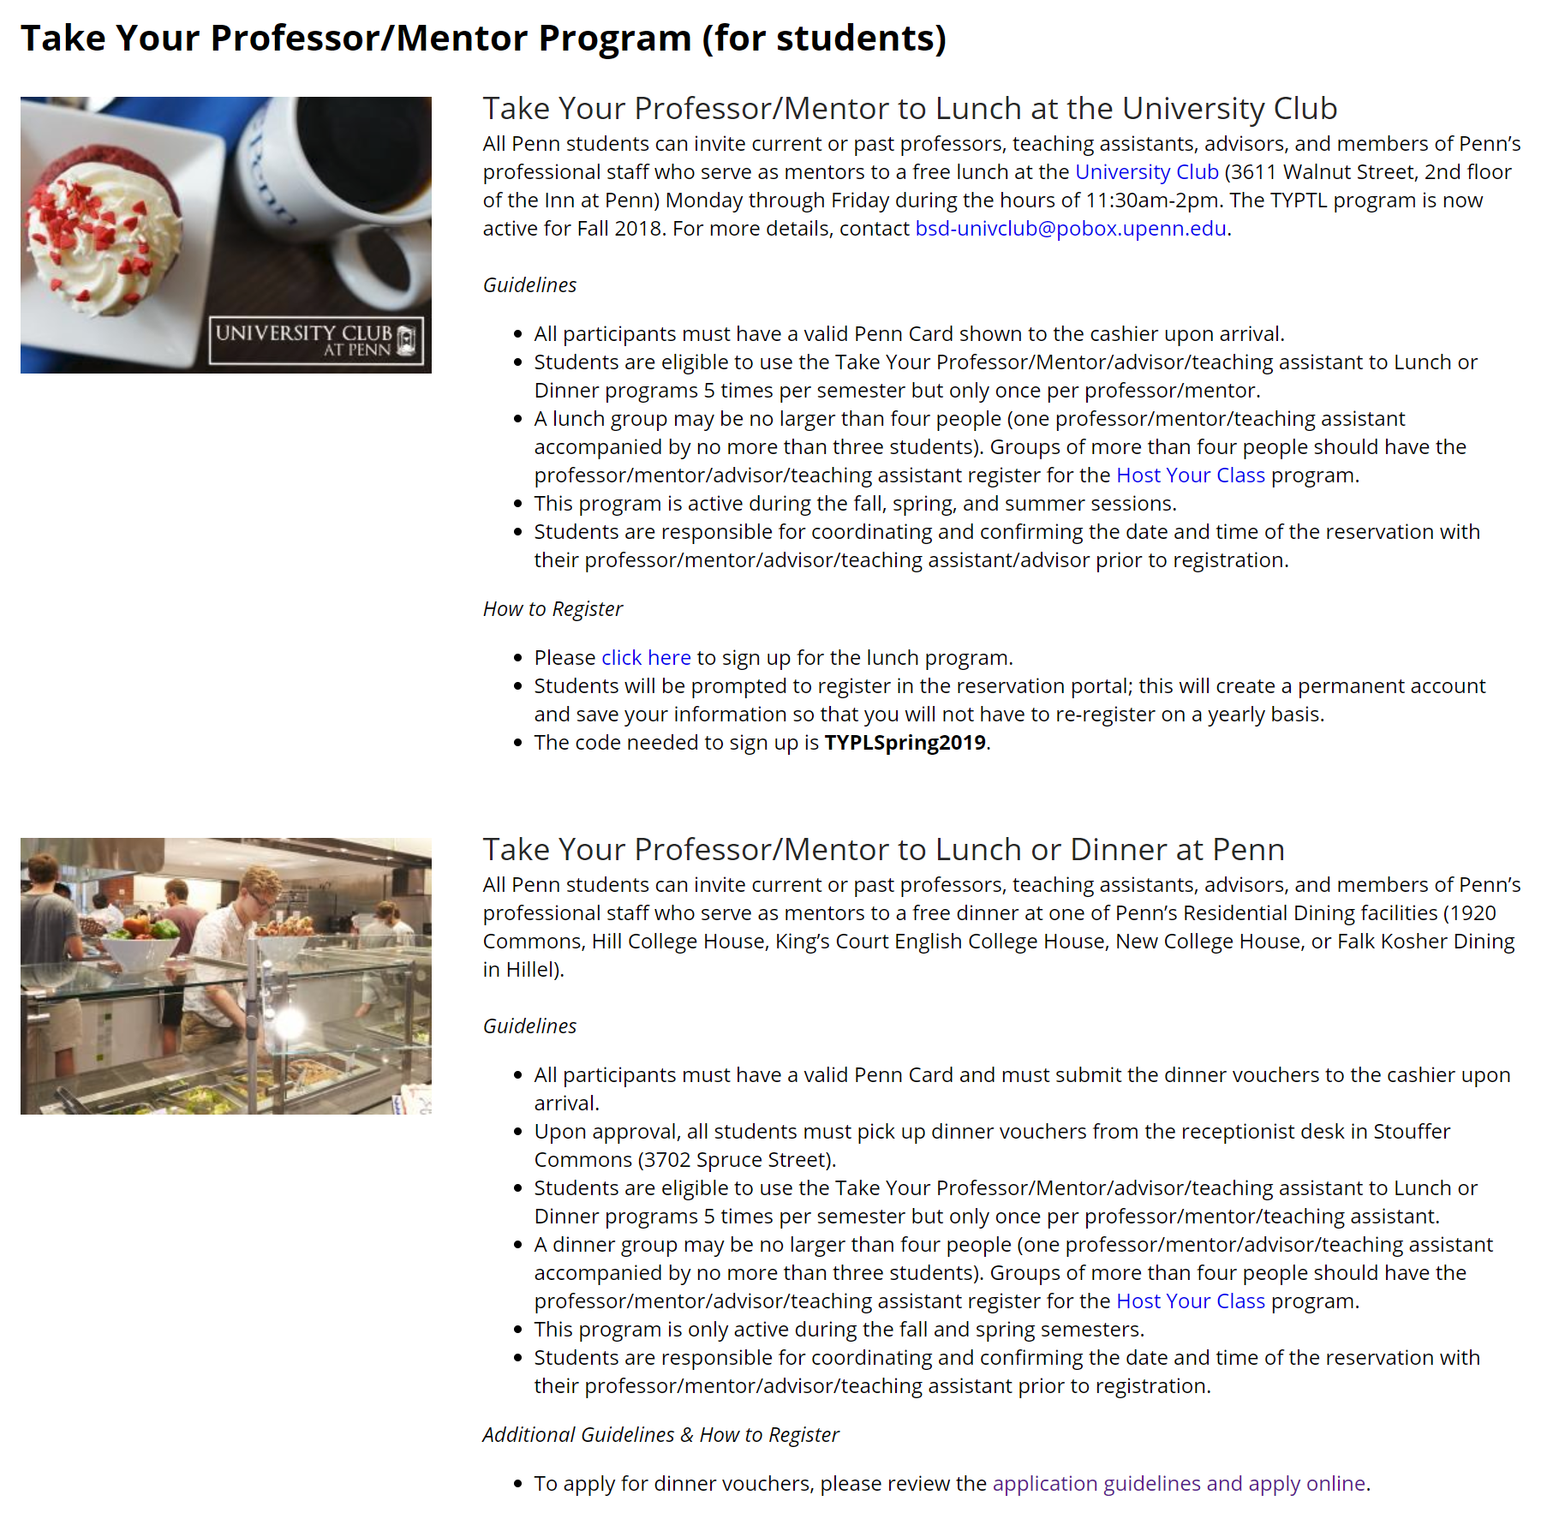
Just a thing I remembered exists...
https://www.nso.upenn.edu/take-your-professormentor-program-students

Slide 2
CIS 700-004: Lecture 14W
Applications of Deep Learning
4/17/19
Notes:
Done

Slide 3
Reminder: your projects are due in less than 2 weeks!
I'd highly recommend having your first working models by the end of the weekend so that you can tune and do the writeup next weekend.
Keep in mind that you'll also have Homework 3 to do in parallel.

Slide 4
Survey of deep learning applications

Slide 5
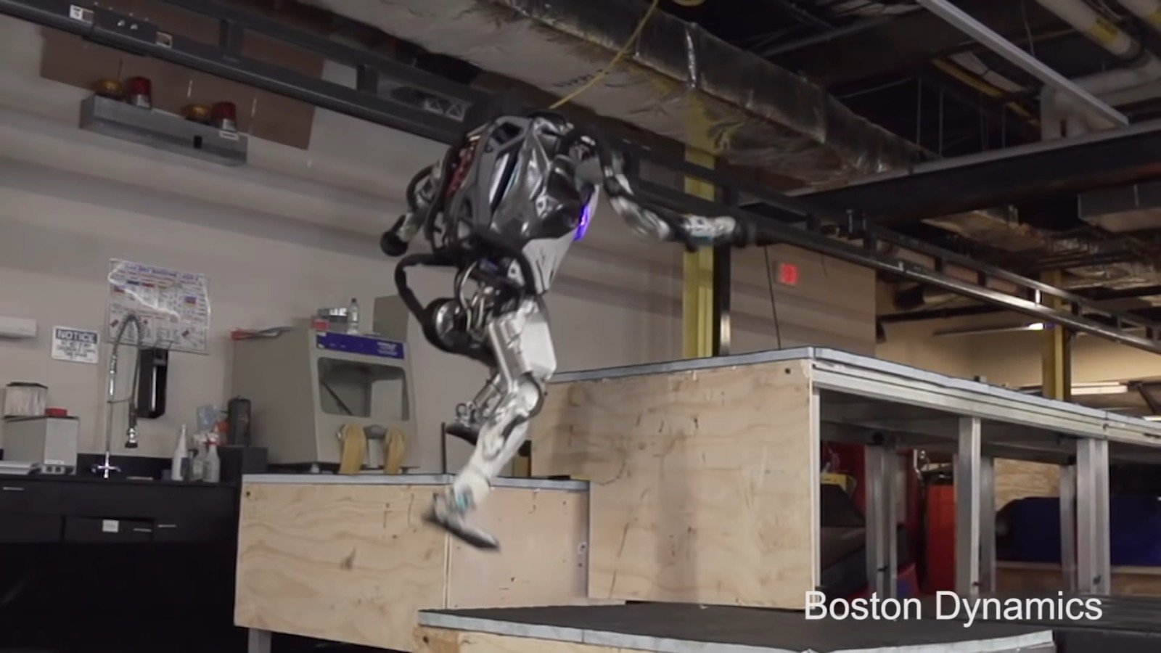
Is this deep learning?
Notes:
Nope, control systems.

Slide 6
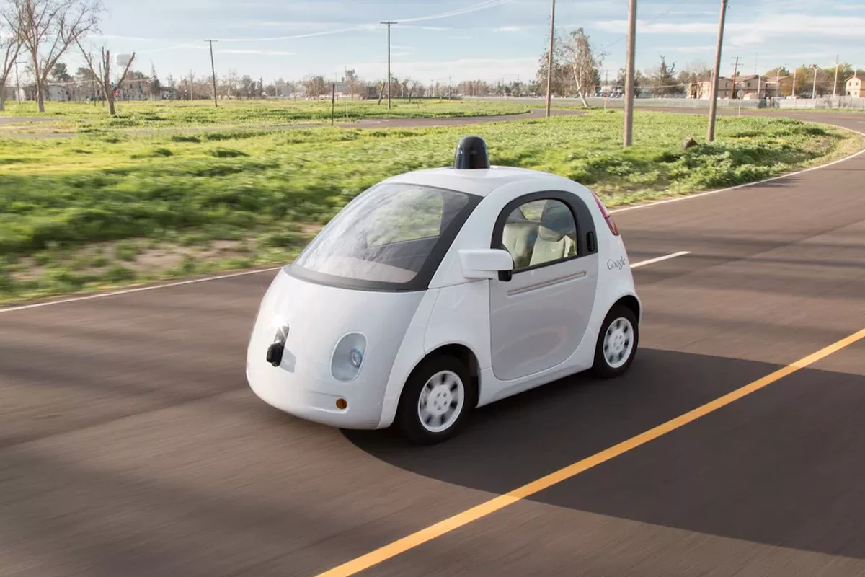
Is this deep learning?
Notes:
Mostly not

Slide 7
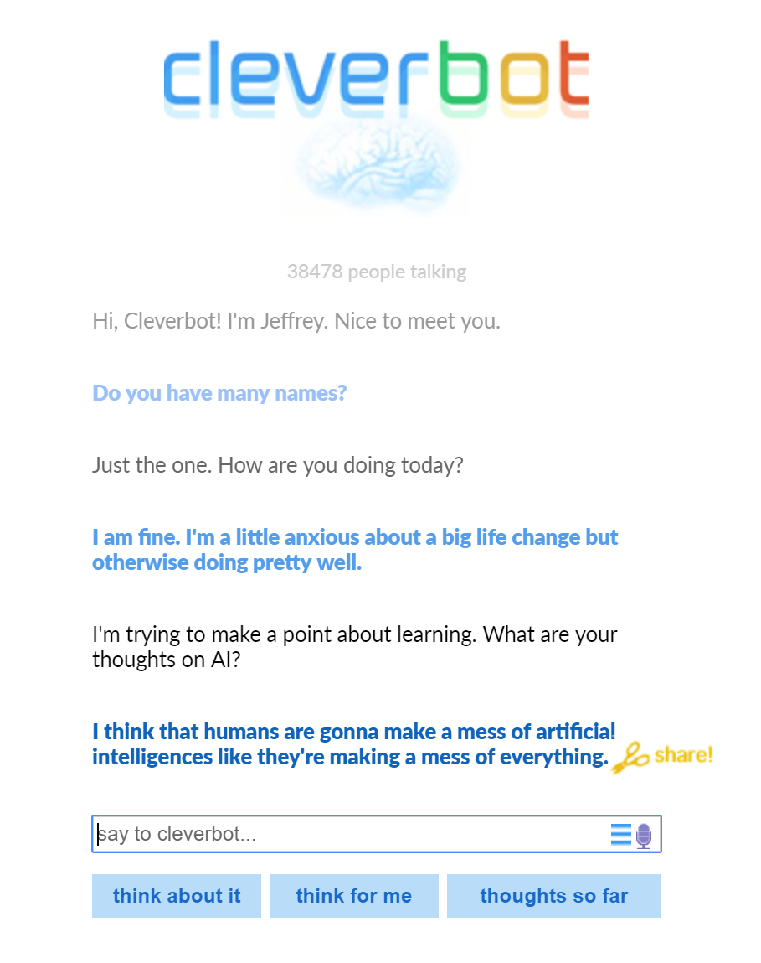
Is this deep learning?
Notes:
Nope, databases.

Slide 8
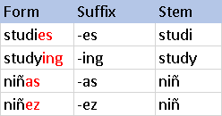
Is this deep learning?
Notes:
Nope, this is rules-based

Slide 9
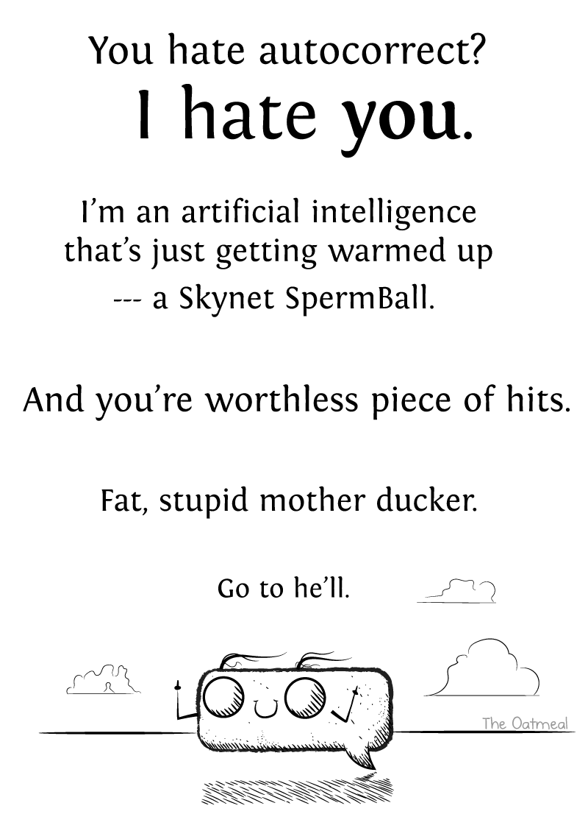
Is this deep learning?
Notes:
Nope, DP and Levenshtein distance. https://www.quora.com/How-are-typing-auto-correct-or-suggest-algorithms-implemented

Slide 10
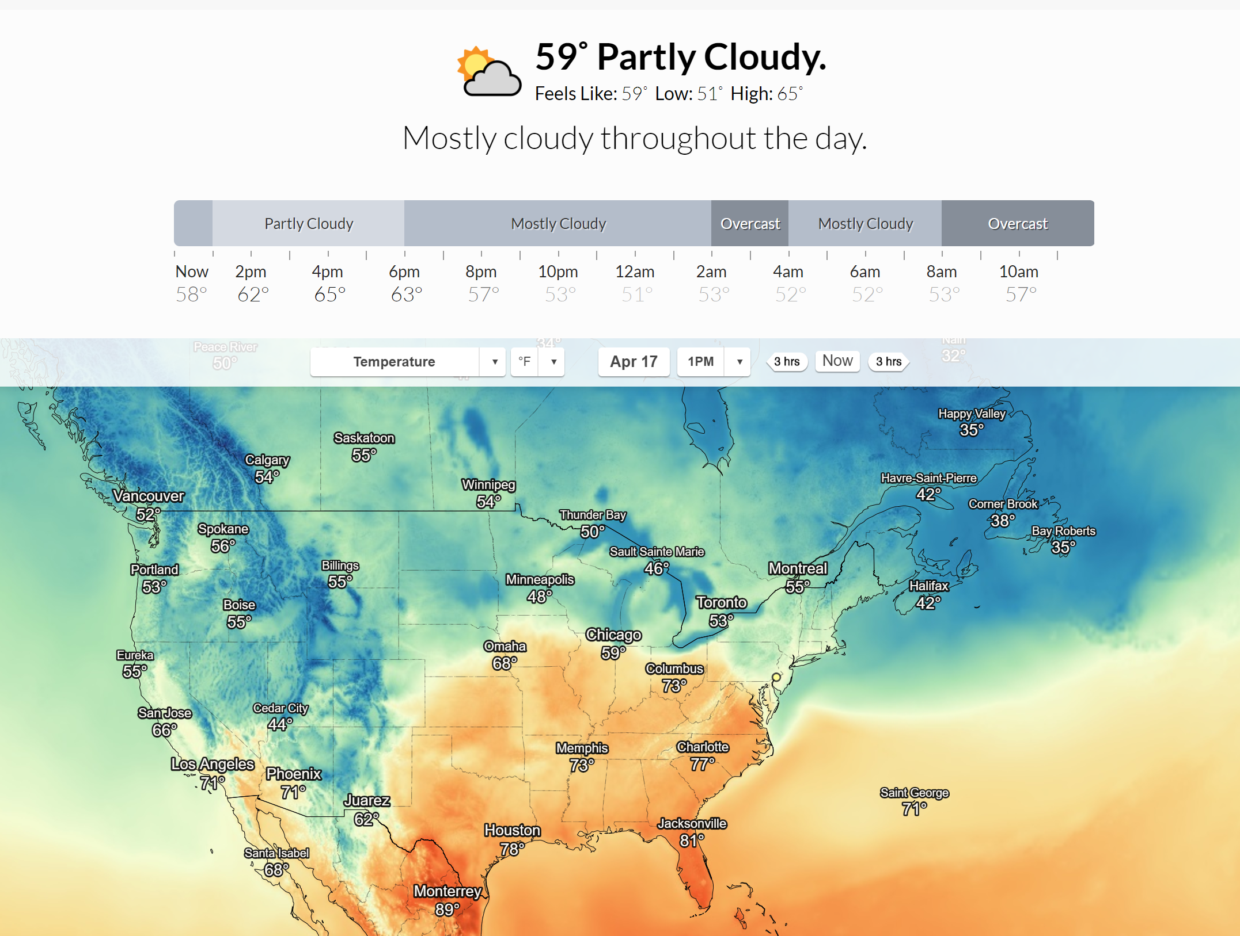
Is this deep learning?
Notes:
Maybe? https://blog.darksky.net/how-dark-sky-works/

Slide 11
When not to use DL
DL is not good enough
No data / domain adaptation / lack of stationarity
Not a learning problem (underlying problem is rules-based)
Exploration is too risky
Accountability

Slide 12
Suppose we have a data pipeline.
If deep learning is part of this applied pipeline, it gets used at some point.

Slide 13
In general, data science is used in 3 places.
The model provides some business intelligence.
A marketing scientist uses a model to optimize advertising mix.
A data scientist helps a manager forecast sales to decide on inventory levels.

Slide 14
In general, data science is used in 3 places.
The model provides some business intelligence.
A marketing scientist uses a model to optimize advertising mix.
A data scientist helps a manager forecast sales to decide on inventory levels.
The model helps you design the product / end.
A data scientist sends a heatmap of all video game deaths to a designer.
A software engineer uses a Mann-Whitney U test for A/B testing two UIs.

Slide 15
In general, data science is used in 3 places.
The model provides some business intelligence.
A marketing scientist uses a model to optimize advertising mix.
A data scientist helps a manager forecast sales to decide on inventory levels.
The model helps you design the product / end.
A data scientist sends a heatmap of all video game deaths to a designer.
A software engineer uses a Mann-Whitney U test for A/B testing two UIs.
The model is the product / end.
A Snapchat filter uses a convnet.
A videogame uses an AI agent as an enemy.

Slide 16
Deep learning for business intelligence

Slide 17
Deep learning for finance
Extracting alternative signals
Counting cars in parking lots
Evaluating sentiment of news headlines
Automating analysis of financial documents
Generalizing linear models
Nonlinear factor models
Notes:
https://arxiv.org/pdf/1602.06561v2.pdf

Slide 18
Deep learning for finance
Extracting alternative signals
Counting cars in parking lots (CNN)
Evaluating sentiment of news headlines (CNN, LSTM, or transformer)
Automating analysis of financial documents (LSTM for entity resolution)
Generalizing linear models
Nonlinear factor models (FFN)
Notes:
https://arxiv.org/pdf/1602.06561v2.pdf

Slide 19
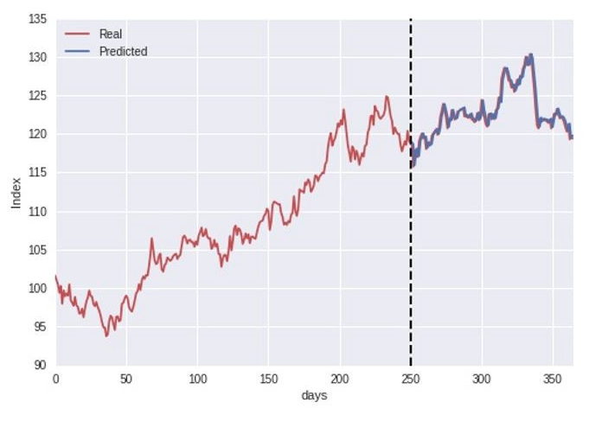
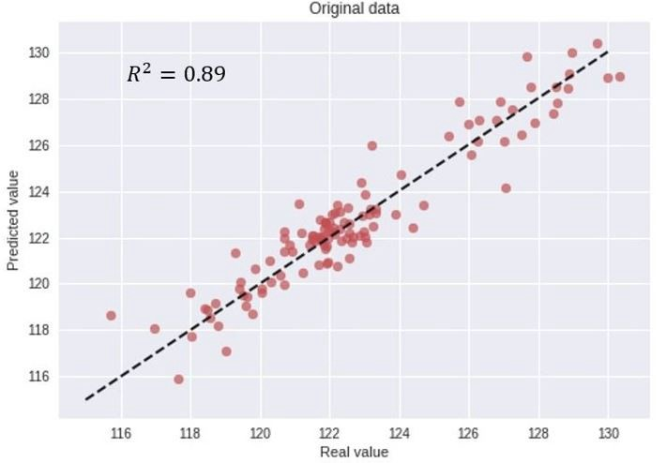
How not to use deep learning in finance
Notes:
https://arxiv.org/pdf/1602.06561v2.pdf

Slide 20
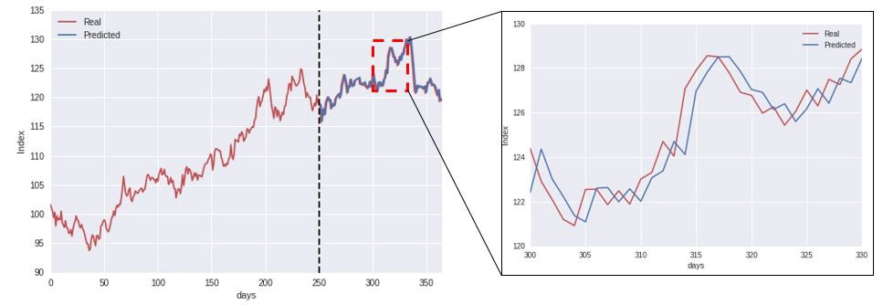
How not to use deep learning in finance
Notes:
https://arxiv.org/pdf/1602.06561v2.pdf

Slide 21
Deep learning for marketing science
Customer engagement
Sentiment analysis on satisfaction surveys
Chatbots for support roles and recording responses
Marketing mix models (MMMs)
Anomaly detection
Fader++
Real-time portfolio optimization
Push advertisements

Slide 22
Deep learning for marketing science
Customer engagement
Sentiment analysis on satisfaction surveys (CNN or LSTM)
Chatbots for support roles and recording responses (rules-based + CNN or LSTM)
Marketing mix models (MMMs)
Anomaly detection (LSTM)
Fader++ (pseudo-Bayesian approach with a deep propensity)
Real-time portfolio optimization (FFN)
Push advertisements (FFN or LSTM)

Slide 23
Deep learning as a design tool
or as an end goal

Slide 24
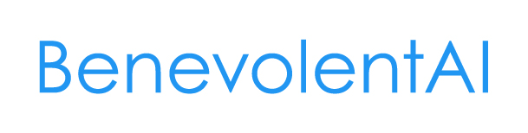



AI for drug discovery

Slide 25
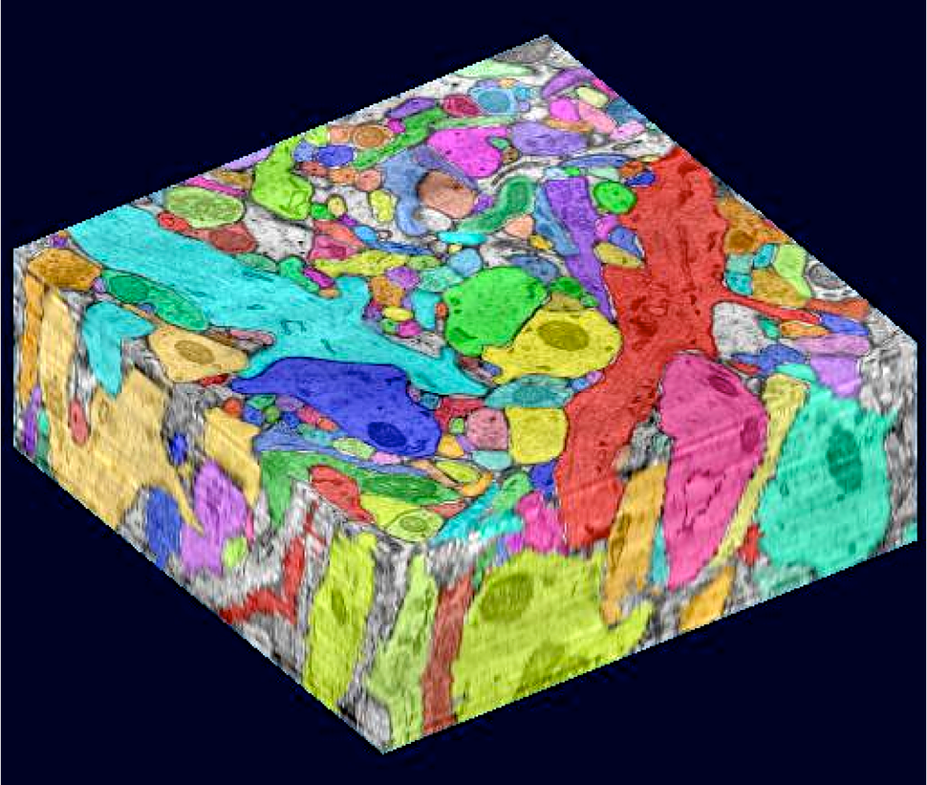
DL for healthcare
Image analytics - detect cancers, stroke, brain hemorrhage, eye disease, etc
GANs to train with privacy
NLP to get at stuff that matters in EHRs
Predict readmissions
Precision medicine

Slide 26
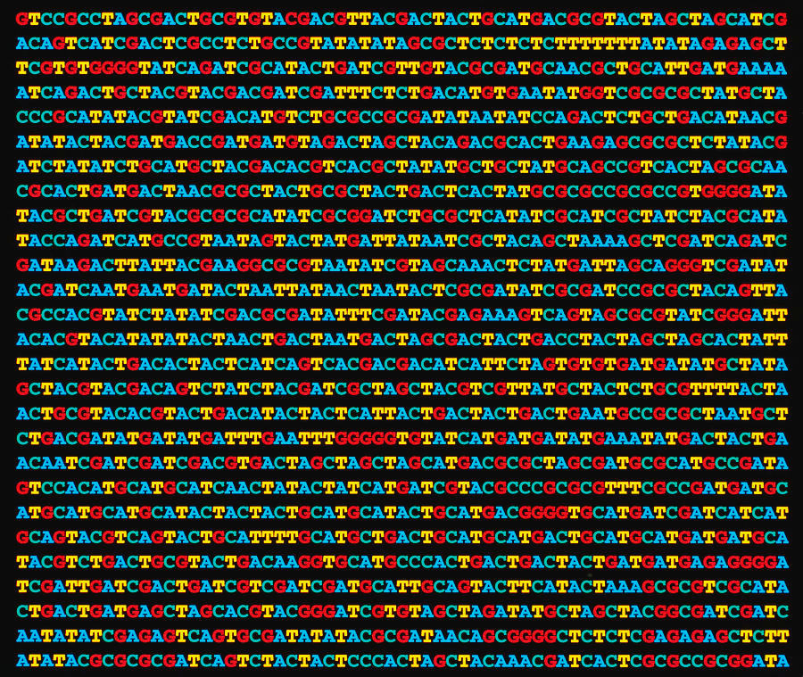
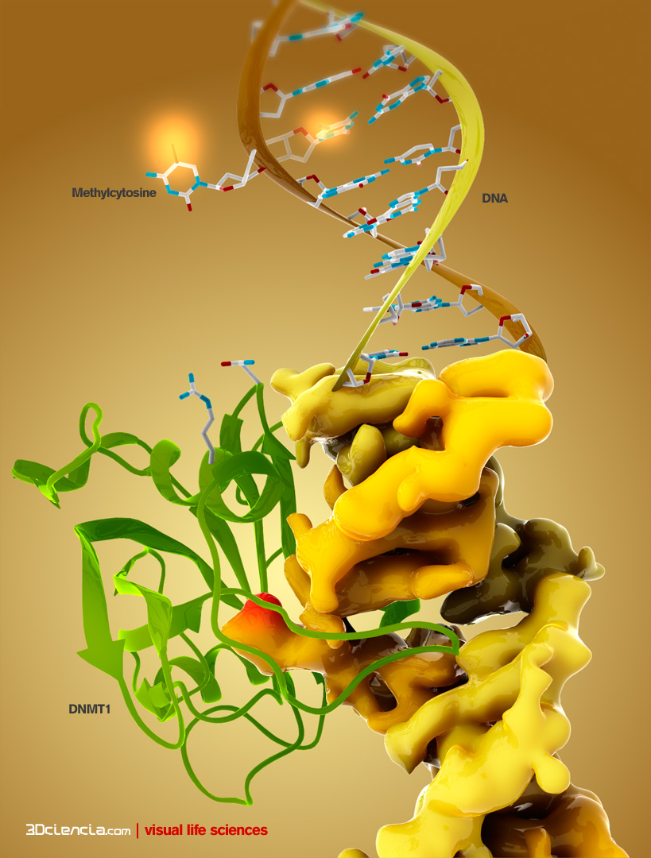
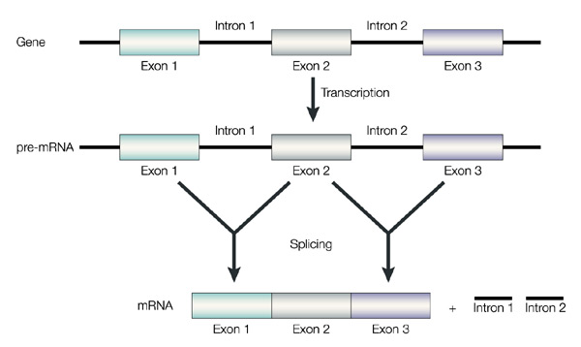
DL for genomics
Predict what binds what
Enhancers
Expression
Splicing
3D organization
Methylation
Phenotype
Pathogens

Slide 27
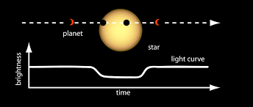
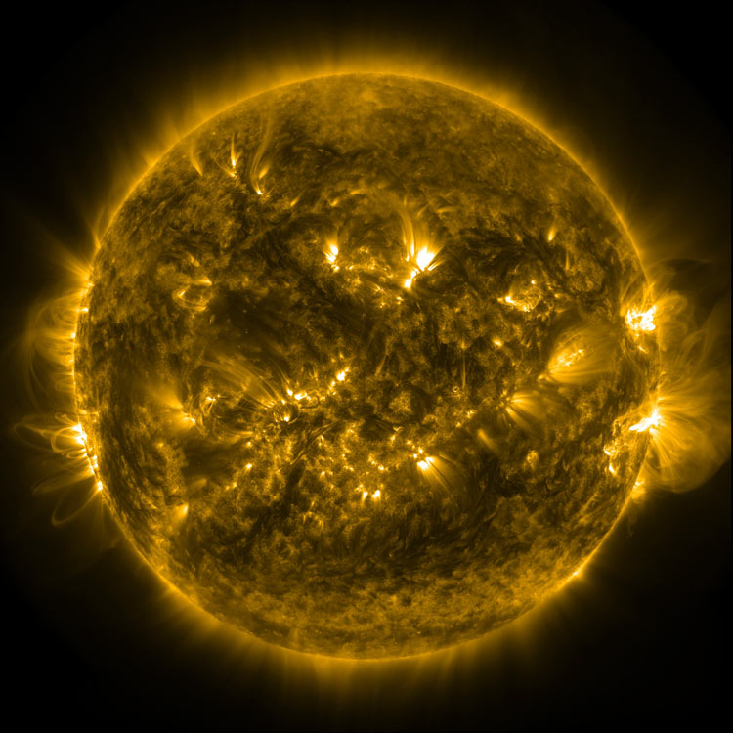
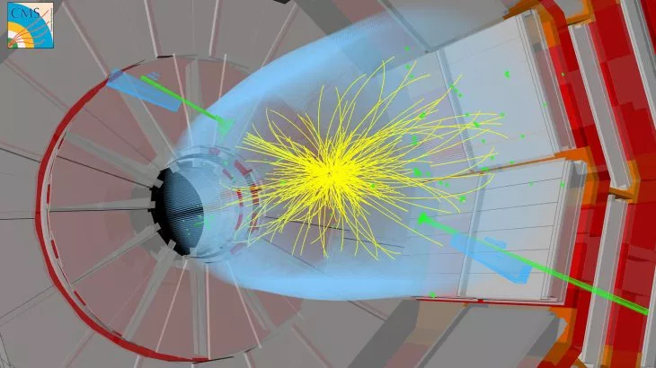
DL for physics
Detect galaxies and stars
Particles in high energy physics
Trigger initiation in LHC
Predict solar flares
RL for reactors
Detect gravitational waves
Predicting extreme weather events

Slide 28
DL for chemistry
Make spectrum calculation fast
Inverting spectrums
Optimal experiment design
Reactor control
Protein-folding
Graph conv networks for molecules
DeepMind algorithm far outperformed all previous work - details not published yet

Slide 29
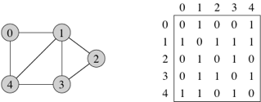
Sidenote: Graph convolutional networks (GCNs)
Graph G with adjacency matrix A
For more info on GCNs:
https://tkipf.github.io/graph-convolutional-networks/

Slide 30
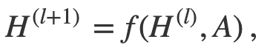
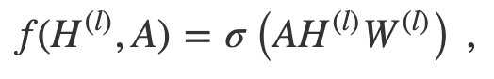
Sidenote: Graph convolutional networks (GCNs)
Graph G with adjacency matrix A
Layers H ^{l} , each dependent on the previous one
The layers are matrices not vectors: num_verts x num_features
What is the analog of normal deep nets?

Slide 31
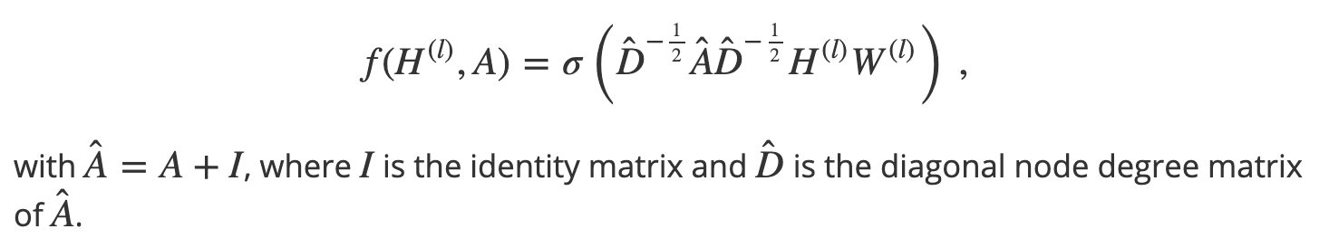
Sidenote: Graph convolutional networks (GCNs)
But A isn’t normalized
Think about the eigenvalues - repeated multiplication will blow up one eigvec.
Normalize A:

Slide 32
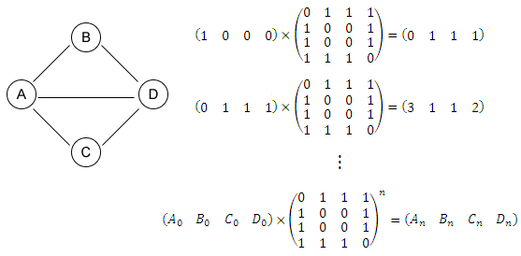
Sidenote: Graph convolutional networks (GCNs)
Why “convolution”?
Multiplying by A is like passing messages to nearby vertices
Like “convolving” by a graph.

Slide 33
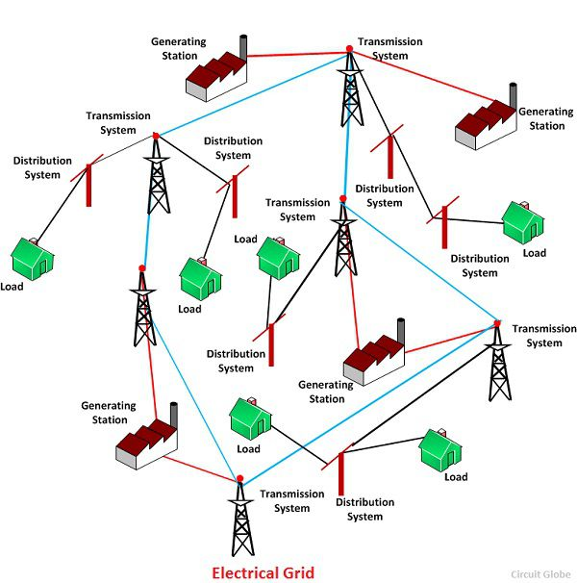
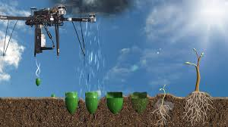
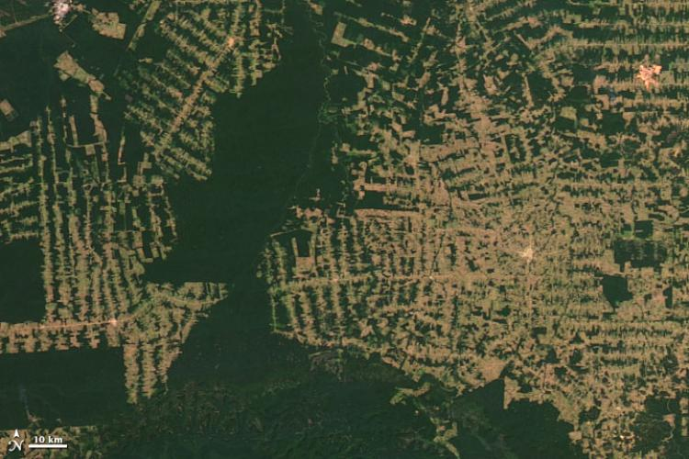
DL for climate change
Power generation and grids
Transportation
Smart buildings and cities
Industrial optimization
Carbon capture and sequestration
Agriculture, forestry and other land use
Climate modeling
Extreme weather events
Disaster management and relief
Societal adaptation
Ecosystems and natural resources
Data presentation and management
Climate finance

Slide 34
AI for Social Good
Movement within the field
There are a LOT of applications of AI
https://aiforsocialgood.github.io/2018/acceptedpapers.htm

Slide 35
AI safety

Slide 36
AI safety
Mostly not about killer robots…
“Concrete Problems in AI Safety” (Amodei, Olah, et al. 2016)

Slide 37
Failure mode 1: Negative side effects
House-cleaning robot that knocks over everything to clean faster

Slide 38
Failure mode 1: Negative side effects
House-cleaning robot that knocks over everything to clean faster
Possible fixes:
Minimize all changes
Minimize irreversible changes
Define what are bad changes
Learn what are bad changes (transfer learning)
Human feedback

Slide 39
Failure mode 2: Reward hacking
Goodhart’s law: "When a measure becomes a target, it ceases to be a good measure."
E.g. a tic-tac-toe AI that learned to encode moves in a very convoluted way…
Or creating more mess just to clean it

Slide 40
Failure mode 2: Reward hacking
Goodhart’s law: "When a measure becomes a target, it ceases to be a good measure."
E.g. a tic-tac-toe AI that learned to encode moves in a very convoluted way…
Or creating more mess just to clean it
Possible fixes:
Guessing where it could cheat in advance
Start with supervised learning not RL
Multiple rewards
Adversarial reward

Slide 41
Failure mode 3: Safe exploration
E.g. self-driving cars

Slide 42
Failure mode 3: Safe exploration
E.g. self-driving cars
Possible fixes:
Supervised learning
Simulation
Human oversight
Bounded exploration
Risk-sensitive rewards

Slide 43
Failure mode 4: Distributional changes
E.g. self-driving in snow - or if a kangaroo crosses the road
Also bias, e.g. when image-recognition databases are all of white people

Slide 44
Failure mode 4: Distributional changes
E.g. self-driving in snow - or if a kangaroo crosses the road
Also a problem e.g. when image-recognition databases are all of white people
Possible fixes:
Better training data
Importance weighting - less common training data more important
Recognize when out-of-distribution at test time

Slide 45
AGI
Artificial general intelligence
Intelligence surpassing that of a human on all tasks
Aka “the singularity”
Goal of DeepMind, OpenAI
Most DL experts think possible, not imminent
Was previously linked to problems like chess, image recognition
We now know this problem is really, really hard
Probably
Maybe just need lots more data and a big LSTM… :)

Slide 46
AGI is confusing
If it happened, could change everything
Intelligence would be capable of advancing itself ever faster (by definition of AGI)
Would we be able to define its objectives?
If we gave it contradictory objectives by accident, what would happen?
Could it be “contained”? Would it need to be?
Would it end up destroying humanity, helping humanity, or neither?

Slide 47
The C word
If we made AGI, would it be conscious?
Is “consciousness” a thing? Does it even matter?

Slide 48
Integrated information
By
Dissent by Scott Aaronson: “the fact that Integrated Information Theory is wrong—demonstrably wrong, for reasons that go to its core—puts it in something like the top 2% of all mathematical theories of consciousness ever proposed. Almost all competing theories of consciousness, it seems to me, have been so vague, fluffy, and malleable that they can only aspire to wrongness.”

Slide 49
“The consciousness prior”

